Slide 1

HOSPITAL PATIENT VITAL SIGNS MONITOR DASHBOARD
Guided by:Dr.jaisharma
Presented by:
Madhumitha Ch S - [1921260101]
M Jayaprithika – [1921260063]
CSA0704 – COMPUTER NETWORKS

Slide 2


Table of Contents
Introduction
Abstract
Problem Statement
Objectives
System Architecture
Dashboard Features
Implementation
Results and Discussion
Advantages and Applications
Challenges and Limitations
Future Scope
Conclusion
References

Slide 3
I INTRODUCTION
A digital dashboard used to monitor a patient’s vital signs.
Displays important health parameters in real time.
Monitors heart rate, blood pressure, temperature, SpO₂, and respiratory rate.
Helps doctors and nurses track patient health easily.
Provides quick alerts when readings become abnormal.
Improves continuous patient monitoring and timely medical care.

Slide 4
ABSTRACT
The Hospital Patient Vital Signs Monitor Dashboard is a digital system designed to monitor and display patients’ vital signs in real time. It tracks parameters such as heart rate, blood pressure, temperature, SpO₂, and respiratory rate. The dashboard provides clear visual information and alerts for abnormal readings, helping healthcare professionals monitor patients efficiently and provide timely care.

Slide 5
PROBLEM STATEMENT
Manual monitoring of patient vital signs can be time-consuming.
Continuous changes in vital signs may not be noticed immediately.
Patient health data can be difficult to organize and track.
Healthcare staff need a centralized monitoring system.
A real-time dashboard is needed to display vital signs and identify abnormal readings quickly.
The system aims to improve efficient patient monitoring and timely response.

Slide 6
OBJECTIVES
To develop a real-time patient vital signs monitoring dashboard.
To monitor heart rate, blood pressure, temperature, SpO₂, and respiratory rate.
To display patient health data in a simple and user-friendly interface.
To identify abnormal vital sign readings quickly.
To provide alerts for critical changes in patient conditions.
To support healthcare professionals in efficient patient monitoring.

Slide 7
SYSTEM ARCHITECTURE
Patient → Sensors → Data Collection → Processing → Database → Dashboard → Doctor/Nurse
Patient: Provides the vital sign data.
Sensors: Measure heart rate, blood pressure, temperature, SpO₂, etc.
Data Collection: Receives readings from the sensors.
Processing: Checks and analyzes the collected data.
Database: Stores patient information and vital sign history.
Dashboard: Displays real-time readings using numbers, graphs, and status indicators.
Doctor/Nurse: Monitors the dashboard and responds to abnormal readings.

Slide 8
DASHBOARD FEATURES
Patient Information – Displays patient ID, name, age, and room number.
Real-Time Monitoring – Shows current vital sign readings.
Vital Signs Display – Heart rate, blood pressure, temperature, SpO₂, and respiratory rate.
Status Indicators – Shows readings as normal or abnormal.
Alerts & Notifications – Gives warnings when readings are outside the set range.
Graphs & Trends – Displays changes in vital signs over time.
Patient History – Stores and displays previous readings.
User-Friendly Interface – Easy for doctors and nurses to monitor patients.

Slide 9
IMPLEMENTATION
Data Collection: Collect patient vital signs using sensors or manually entered data.
Data Processing: Process and validate the collected readings.
Database: Store patient details and vital-sign history securely.
Dashboard Development: Display readings using charts, graphs, and status indicators.
Alert System: Generate alerts when readings cross predefined limits.
Real-Time Update: Continuously update the dashboard with the latest readings.
User Access: Allow authorized healthcare staff to view and monitor patient data.

Slide 10
MODULE-1 HARDWARE AND DATA COLLECTION
Sensors: Measure heart rate, blood pressure, temperature, SpO₂, and respiratory rate.
Microcontroller: Collects and processes sensor readings.
Data Acquisition: Receives vital-sign data from the sensors.
Communication: Transfers collected data to the monitoring dashboard.
Patient Identification: Links the readings with the correct patient.
Data Storage: Stores the collected readings for further monitoring and analysis.

Slide 11
MODULE – 2 DASHBOARD AND SOFTWARE
Dashboard Interface: Displays patient vital signs clearly.
Real-Time Monitoring: Shows the latest readings continuously.
Data Visualization: Uses graphs and charts to show vital-sign trends.
Alert System: Indicates abnormal or critical readings.
Patient Management: Displays patient details and monitoring history.
Database: Stores patient information and vital-sign records.
Software Processing: Analyzes and updates the collected data.

Slide 12
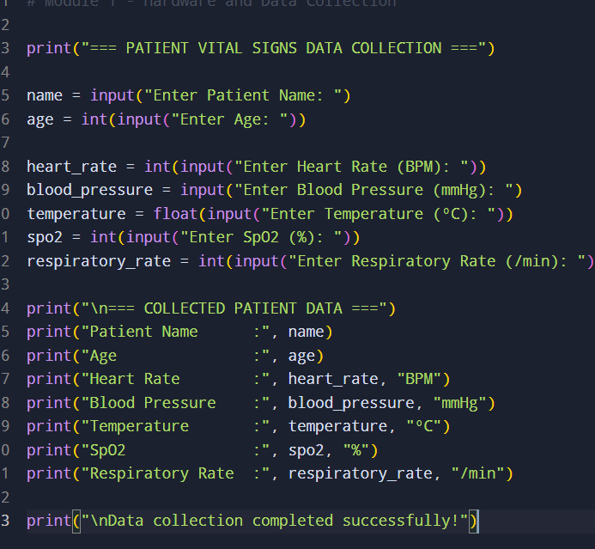
MODULE-1- APPLICATION

Slide 13
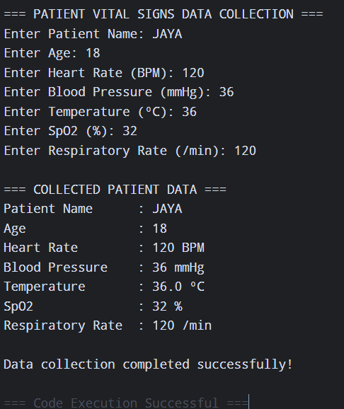
MODULE -1 -APPLICATION

Slide 14
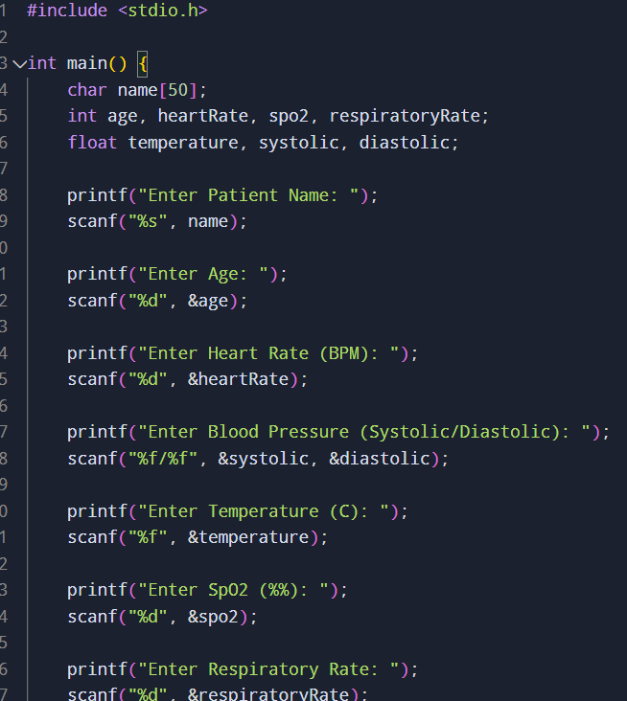
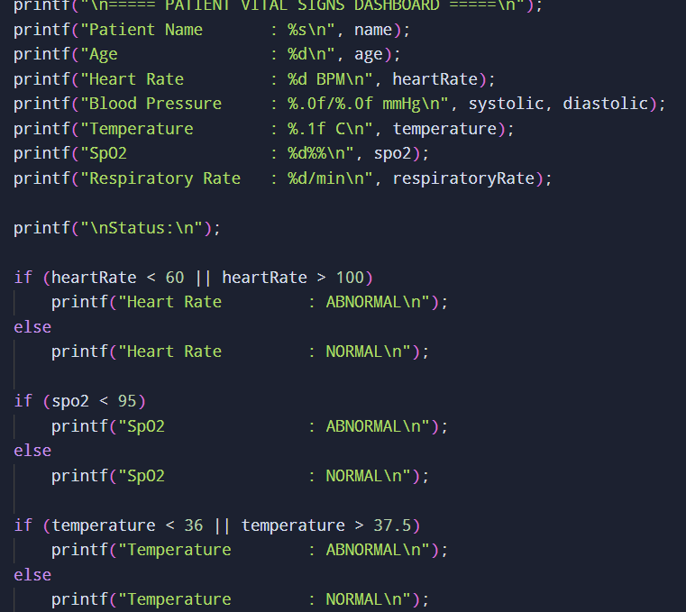
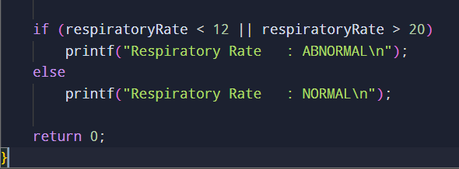
MODULE-2-APPLICATION

Slide 15
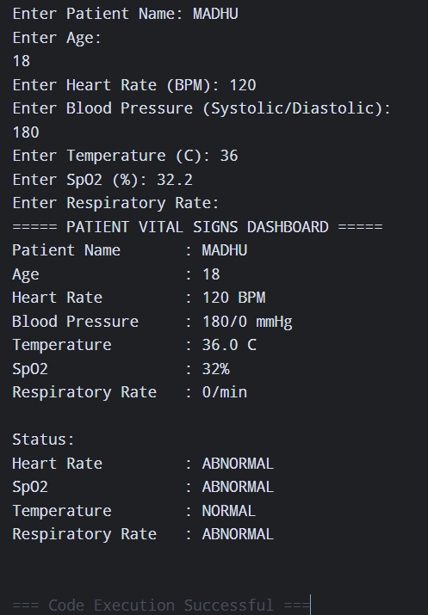
MODULE-2-APPLICATION

Slide 16
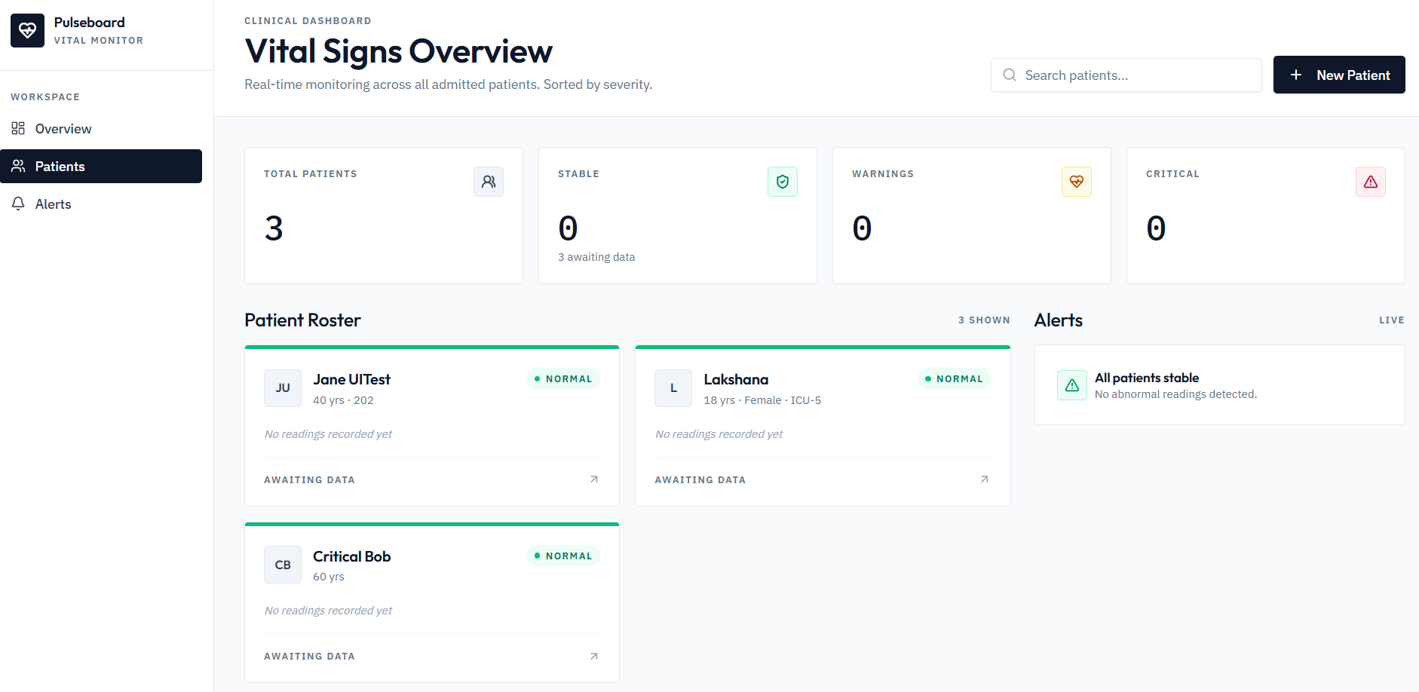
WEB PAGE

Slide 17
RESULT AND DISCUSSION
The dashboard successfully displays patient vital signs in real time.
Heart rate, blood pressure, temperature, SpO₂, and respiratory rate can be monitored easily.
Graphs and status indicators make changes in vital signs easy to understand.
The alert system helps identify abnormal readings quickly.
Patient data can be stored and reviewed for monitoring trends.
Overall, the system provides efficient and user-friendly patient monitoring.

Slide 18
ADVANTAGES AND APPLICATIONS
Advantages
Real-time patient monitoring
Quick detection of abnormal readings
Easy-to-use dashboard
Reduces manual monitoring
Supports timely medical decisions
Applications
Hospitals and wards
ICU and critical care
Emergency departments
Remote patient monitoring
Healthcare research

Slide 19
CHALLENGES AND LIMITATIONS
Sensor Accuracy: Sensors may sometimes provide inaccurate readings.
Real-Time Connectivity: Network failure can interrupt data updates.
System Reliability: Hardware or software failures may affect monitoring.
Data Security: Patient information needs strong privacy protection.
Maintenance: Sensors and devices require regular maintenance.
Limited Functionality: The dashboard monitors vital signs but does not diagnose diseases.

Slide 20
FUTURE SCOPE
IoT Integration – Connect medical sensors for continuous real-time monitoring.
AI-Based Analysis – Use AI to identify unusual vital-sign patterns.
Cloud Storage – Store patient data securely for easy access.
Mobile Application – Allow healthcare staff to monitor patients remotely.
Advanced Alerts – Provide early warnings for critical changes.
Predictive Monitoring – Analyze trends to support early intervention.

Slide 21
CONCLUSION
The Hospital Patient Vital Signs Monitor Dashboard provides an efficient way to monitor patient health.
It displays vital signs in real time through a simple interface.
Alerts help identify abnormal readings quickly.
Graphs and stored data support easy tracking of patient conditions.
The system can improve monitoring efficiency and timely medical response.
Future technologies such as IoT, AI, and cloud computing can further enhance the system.

Slide 22
REFERENCES
World Health Organization (WHO) – Digital Health and Health Technologies
Centers for Disease Control and Prevention (CDC) – Vital Signs
Arduino Documentation – Sensors and IoT Projects
National Institute of Biomedical Imaging and Bioengineering (NIBIB) – Medical Devices and Monitoring
Research articles on Patient Vital Signs Monitoring Systems and Healthcare Dashboards

Slide 23
THANK YOU!

